Slide 1
Section 2: Introduction

Slide 2
Section 2: Overview
Chapters 1 and 2 in textbook Operating System Concepts
Overall computer system
Computer hardware
User interfaces
OS versus kernel
User mode / kernel mode
System calls
Interrupts

Slide 3
Computer system structure
Computer system can be divided into four components:
Users
People, machines, other computers
Application programs – define the ways in which the system resources are used to solve the computing problems of the users
Word processors, compilers, web browsers, database systems, video games
Operating system
Controls and coordinates use of hardware among various applications and users
Hardware – provides basic computing resources
CPU, memory, I/O devices

Slide 4

View of computer system structure

Slide 5

Computer System Hardware
Computer-system hardware
One or more CPUs, device controllers connect through common bus providing access to the memory and other I/O devices

Slide 6
Input/Output (I/O) devices
I/O devices consist of storage devices (disks, tapes), transmission devices (network connections, Bluetooth), and human-interface devices (screen, keyboard, mouse,audio in and out)
I/O devices have two physical parts: a controller and the device itself
A device controller is a chip that physically controls the device

Slide 7
Storage (memory)
Storage system organized in a hierarchy; each level of the hierarchy has different
Speed
Cost
Volatility

Slide 8

Storage-device hierarchy

Slide 9
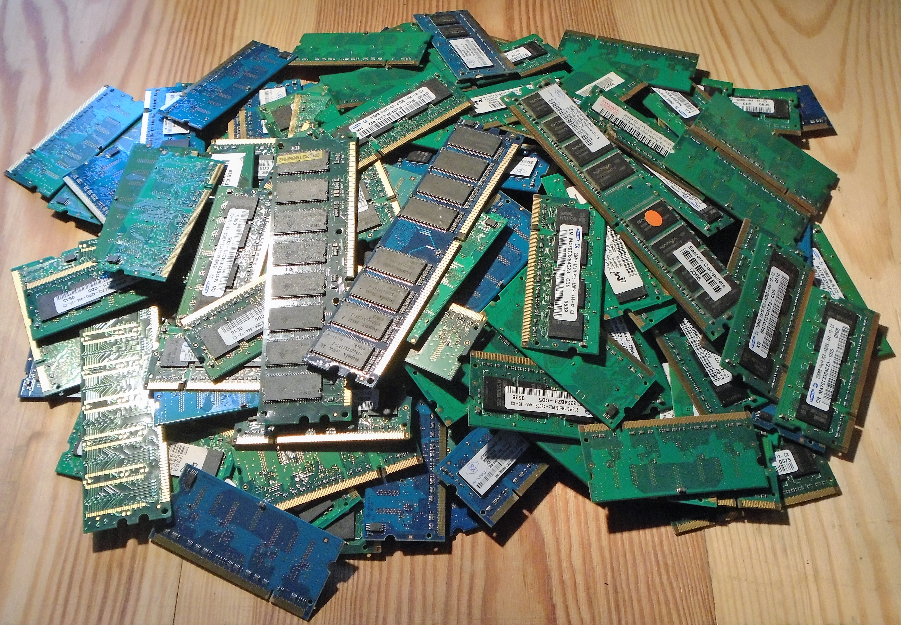
Main memory
Main memory – is the only large storage media that the CPU can access directly
Typically volatile
Typically random-access memory in the form of Dynamic Random-access Memory (DRAM)

Slide 10
Storage Structure
Main memory – is the only large storage media that the CPU can access directly
Typically volatile
Typically random-access memory in the form of Dynamic Random-access Memory (DRAM)
Secondary storage – extension of main memory that provides large nonvolatile storage capacity

Slide 11

Characteristics of Various Types of Storage
Movement between levels of storage hierarchy can be explicit or implicit

Slide 12
Computer time units at human scale
1 ns = 1/1 billion of a second
A 2Ghz CPU executes one instruction every 0.5ns
In order to bring execution time of computer operations to human scale, let assume that 0.5n = 1 second
Note, the fastest typist can type a keystroke every 100ms

Slide 13
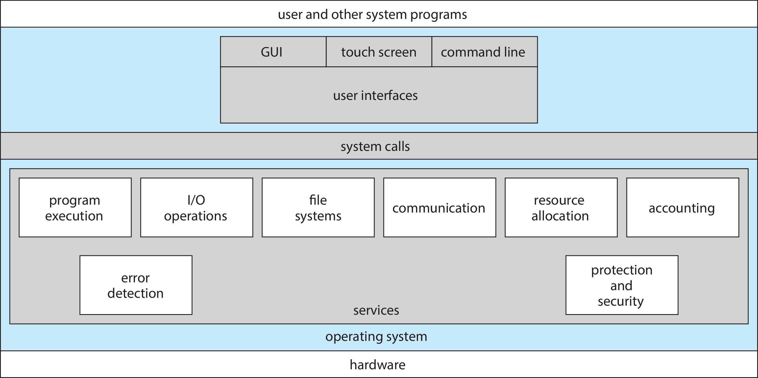
User interfaces

Slide 14
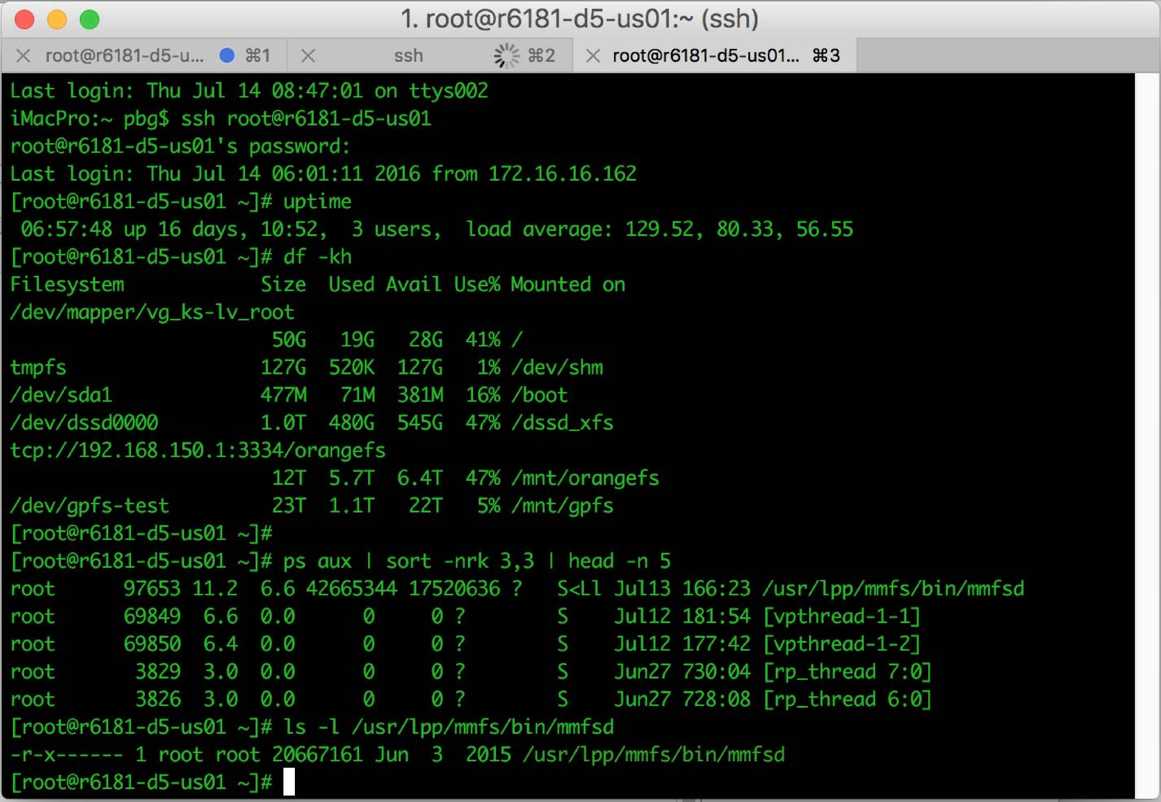
Command line interpreter

Slide 15
Command Line interpreter
CLI allows direct command entry
Primarily fetches a command from user and executes it
Sometimes commands built-in, sometimes just names of programs
If the latter, adding new features doesn’t require shell modification
Sometimes implemented in kernel, sometimes by systems program
Sometimes multiple flavors implemented – shells Ubuntu has Bourne shells (bash, sh, zsh)

Slide 16
Graphical User Interfaces - GUI
User-friendly desktop metaphor interface
Usually mouse, keyboard, and monitor
Icons represent files, programs, actions, etc
Various mouse buttons over objects in the interface cause various actions (provide information, options, execute function, open directory (known as a folder)
Invented at Xerox PARC
Many systems now include both CLI and GUI interfaces
Microsoft Windows is GUI with CLI “command” shell
Apple Mac OS X is “Aqua” GUI interface with UNIX kernel underneath and shells available
Unix and Linux have CLI with GUI interfaces (CDE, KDE, GNOME)

Slide 17
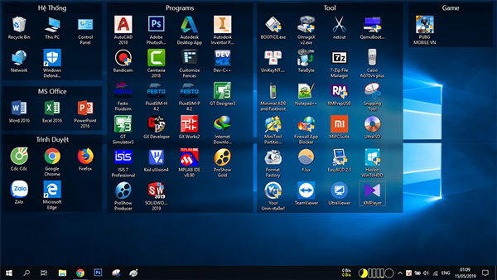
Windows 10 screen desktop

Slide 18

Touchscreen Interfaces
Touchscreen devices require new interfaces
Mouse not possible or not desired
Actions and selection based on gestures
Virtual keyboard for text entry
Voice commands

Slide 19
Difference between OS and kernel
The kernel is a program (object) that is part of the OS
Process and memory management is done by the kernel while interfacing with the user such as desktop icons or command line interpreters (terminals) are part of the OS but not in the kernel
Note, the kernel is stored in a protect area of the main memory called the kernel space, no other programs can access this part of main memory

Slide 20
User mode / kernel mode
Most computers have at least two modes of operation: kernel mode and user mode
The code of most of the services provided by the OS is accessed in kernel mode
This code is executed in kernel mode since instructions in this code have access to all the hardware and can execute any machine instruction the computer is capable of executing
The rest of the software, in particular the user code, always runs in user mode where only a subset of the machine instructions is available

Slide 21
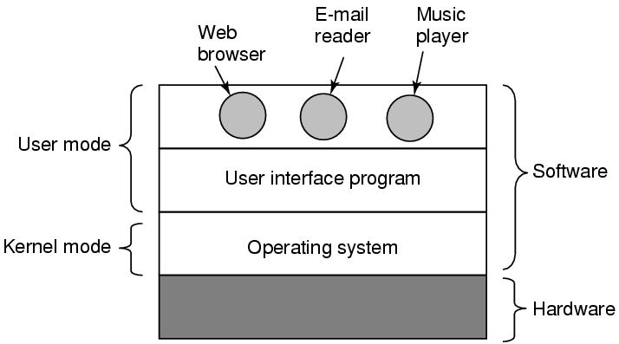
User mode / kernel mode

Slide 22

Transition from user to kernel mode
To obtain services from the operating system, a user program must make a system call, which invokes the kernel.
In order to execute kernel mode instructions the system must switch from user mode to kernel mode and starts running code from the kernel in order to answer the system call

Slide 23
Transition from user to kernel mode
The system call executes a “trap instruction” which causes a change in the value of the mode bit
The mode bit is stored in a register of the CPU and is used by the system to decide whether a hardware instruction is allowed to execute

Slide 24
Transition from user to kernel mode
Once the mode bit is set to 0, the kernel instructions related to the service requested by the system call are then executed
Prior to return to user mode, the mode bit is reset to user mode status

Slide 25
System calls
System calls provide an interface to the services made available by an operating system
For example, if a user program want to read a file, it cannot read the file directly, it has to ask the OS to do it, through system calls
Same for opening a file, loading a program, changing directory, executing a program, and many more
There are many system calls, for example one particular Linux kernel has 393 different system calls:
getitimer(), getpageside(), getpid(), fork(), open(), close(), read(), reboot(), getcpu(), write()
You can find the source code of Linux system calls in the Linux kernel source which anyone can download

Slide 26

System Call Implementation
Typically, a number is associated with each system call
System-call interface maintains a table indexed according to these numbers

Slide 27
Types of system calls
System calls can be grouped roughly into six major categories: process control, file management, device management, information maintenance, communications, protection.
Process control
create process, terminate process
end, abort
load, execute
get process attributes, set process attributes
wait for time
wait event, signal event
allocate and free memory
Locks for managing access to shared data between processes

Slide 28
Types of system calls (Cont.)
File management
create file, delete file
open, close file
read, write, reposition
get and set file attributes
Device management
request device, release device
read, write, reposition
get device attributes, set device attributes
logically attach or detach devices

Slide 29
Types of system calls (Cont.)
Information maintenance
get time or date, set time or date
get system data, set system data
get and set process, file, or device attributes
Communications
create, delete communication connection
send, receive messages if message passing model to host name or process name
From client to server
Shared-memory model create and gain access to memory regions
transfer status information
attach and detach remote devices

Slide 30
Types of system calls (Cont.)
Protection
Control access to resources
Get and set permissions
Allow and deny user access

Slide 31
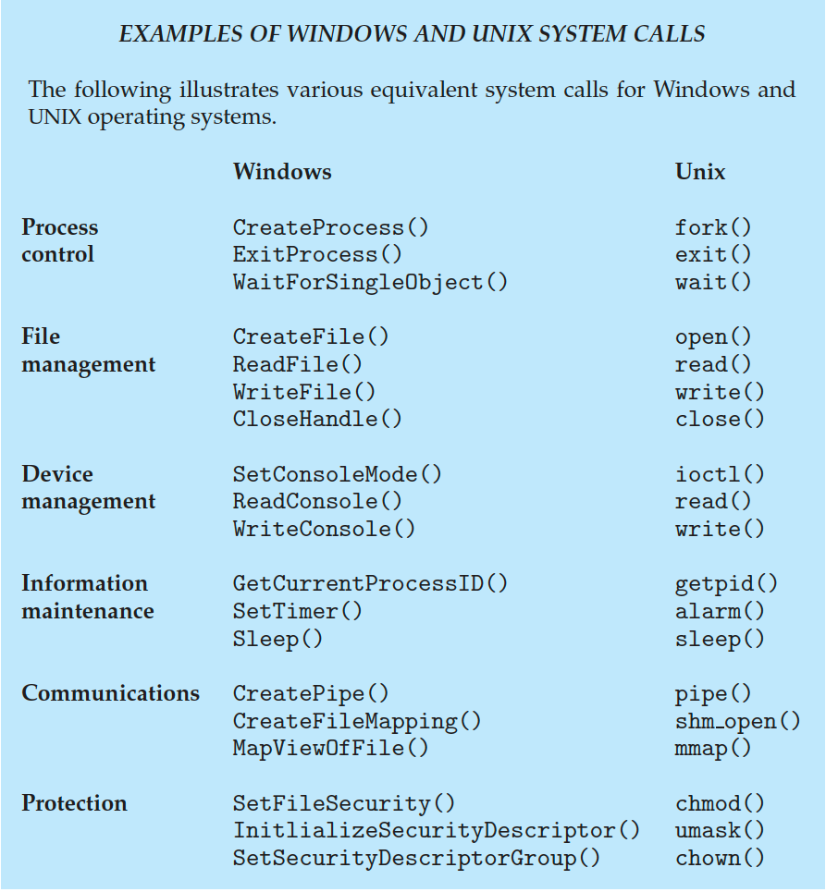
Examples of Windows and Unix System Calls

Slide 32
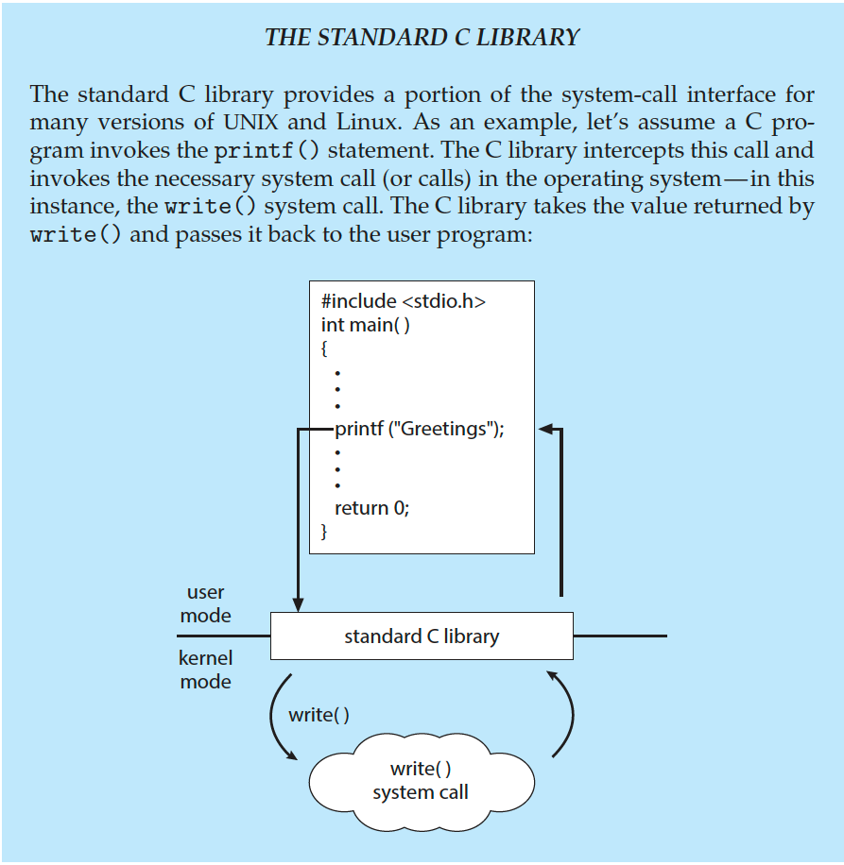
Standard C Library Example
C program invoking printf() library call, which calls write() system call

Slide 33
Interrupts
I/O devices occasionally need to be serviced by the CPU
e.g. Inform CPU that a key has been pressed
These events are asynchronous i.e. we cannot predict when they will happen.
Need a way for the CPU to determine when a device needs attention
The CPU is made aware of I/O devices activities through interrupts which are signals sent on system bus

Slide 34
Interrupts
A device controller raises an interrupt by asserting a signal on the interrupt request line (one of the lines on the system bus)
After executing each hardware instruction, the CPU checks the interrupt request line if an interrupt has been raised
Interrupts tell the CPU to stop its current activities and execute the appropriate part of the OS that handles interrupts for a particular device
An operating system is essentially an interrupt driven system, servicing user’s tasks until it get interrupted by an external event such as keyboard stroke

Slide 35
Interrupt-drive I/O Cycle

Slide 36
Handling Interrupts
Different routines handle different interrupts – called Interrupt Service Routines (ISR) (device drivers)
When CPU is interrupted, it stops what it was doing, a generic routine called Interrupt Handling Routine (IHR) is run
This code examines the nature of interrupt, through the interrupt vector, which contains the addresses of all the service routines
Which then calls the corresponding Interrupt Service Routine (ISR) (for example code inside a device driver)
After servicing the interrupt, the CPU resumes the interrupted computation

Slide 37
End of Introduction

